Slide 1


WORKING GROUP 3 COLLECTIONS ARENA
WORKING SESSION
1st GENERAL MEETING
Ciudad Real, 20th February 2018

Slide 2
Task 3.1
Review existing raptor collections in Europe, [Oct 2017 – Sep 2019], includes consideration of:
  existing collections;
  current collecting activities;
  storage facilities;
  current provision for research access to collections, samples exchange;
  constraints to collection, transport and storage of samples.
    D3.1 Report & peer reviewed paper on existing collections in Europe, constraints (Sep 2019]

Slide 3
Questions Task 3.1
Review existing raptor collections in Europe
What is the scope of the Task?
How does it relate to the Field and Analysis arenas?
How can we implement the Task?
  STSM(s)?
  Task Group?
  Other activities?
How can we maximise engagement of NHMs, ESBs and other collections?
Who wants to join a Collections Review Task Group? And who else might we invite?

Slide 4
Offer from NHM Belg to increase collection and is longterm solution, needs advice on storage of different tissues, feather easy and can be linked to ringed individuals and their history, value of ringed birds and link to Ringing Schemes, link to Mus facilitates permissions, Museums should provide access by remit
Museum in NL collecting PE tissues
AV – museums opportunity to collect tissues for subsequent analyses, issue is storage protocols
RD - exisiting collaboration among museums offers opportunity at their yearly meetings to raise profile of this initiative and provide advice on protocols in preparing specimens and tissue storage
Q. on databases

Slide 5
Task 3.2
Develop framework for a distributed European Raptor Specimen Bank (ERSpeB) for contaminant monitoring [Oct 2018 – Sep 2020], includes consideration of:
  collecting priorities (in relation to needs of WGs1&2);
  potential for collections to accept new specimens from the field arena;
  sources for new specimens (in relation to WG3);
  storage needs;
  potential to establish new (regional) collections;
  enhanced provision for research access to collections;
  measures to resolve constraints to collection, transport, storage of samples.
    D3.2 Technical specs and peer-reviewed paper on ERSpeB framework. [Sep 2020]

Slide 6
Questions Task 3.2
Develop framework for a distributed European Raptor Specimen Bank (ERSpeB)
What do we mean by a ‘distributed’ European Raptor Specimen Bank?
What issues should be addressed within the ‘Framework’ for the EPSpeB?
How does it relate to the Field and Analysis arenas?
How can we implement the task?
  STSM(s)?
  Task Group?
  Other activities?
How can we maximise engagement of NHMs, ESBs and other collections?
Who wants to join a ERSpeB Framework Task Group? And who else might we invite?

Slide 7
Task 3.3
  Design and construct a meta-database (linked to IPCheM) of existing raptor specimens and of any related contaminant data [Apr 2019-Jun 2021] involving:
  developing standards for the digital description and online publication of raptor samples and related data;
  developing systems and protocols for web-based exchange, analysis and mapping of this data;
  stimulating digitisation of collections.
    D3.3 Meta-database of raptor specimens, linked to IPCheM. [Jun 2021]

Slide 8
Questions Task 3.3
Design and construct a meta-database
What should be the purpose and scope of the meta-database?
How does it relate to the Field and Analysis arenas?
How can we implement the task?
  STSM(s)?
  Task Group?
  Other activities?
How can we maximise engagement of NHMs, ESBs and other collections?
Who wants to join a Meta-database Task Group? And who else might we invite?

Slide 9
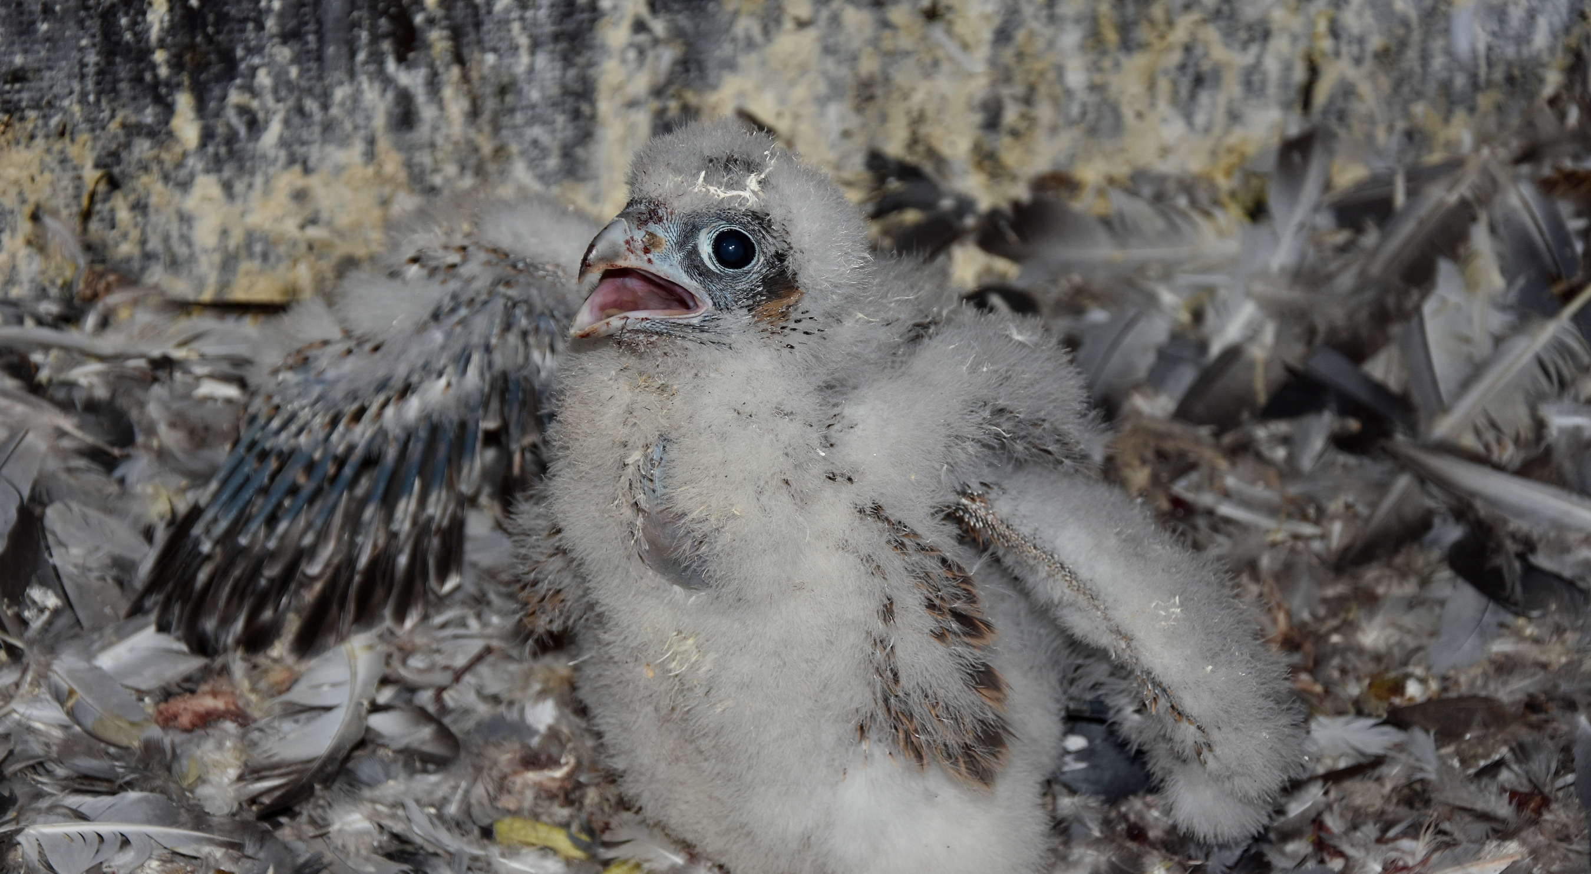
THANK YOU

