Slide 1
Work Groups (WG) 1 & 2
Richard Shore, Igor Eulaers (WG1)
Antonio Garcia-Fernandez, Rafael Mateo (WG2)

Slide 2
KeY activities: T1.2, 2.2. Months 18-36
Develop framework for European Raptor Biomonitoring Scheme
(ERBioMS) using priority species and matrices
Identify appropriate species (and read across methods for species within trophic guilds)
Identify sample matrices based on Espin et al 2016
Identify scientific methodology
Relate to WG3 and WG4 (logistics)

Slide 3
KeY activities: T1.2, 2.2. Months 18-36
Develop framework for European Raptor Biomonitoring Scheme (ERBioMS) using priority species and matrices
Deliverable: D1.2, 2.2 M36 Technical specs and peer-reviewed papers detailing the ERBioMS framework and read-across techniques
NEXT STEPS
Bring forward species consideration for pan European monitoring. Two elements:
Consideration of scientific considerations and issues. Task group to be led and formed by NVdB to cover off key scientific issues and produce opinion paper (Environmental Pollution?)
Practical issues with collections with WG3 and WG4 discussed in a workshop in the autumn to identify key species and sample collection issues

Slide 4
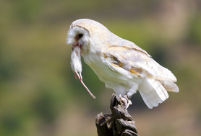
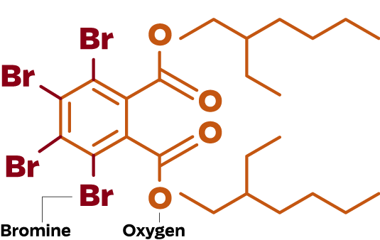
KeY activities: T1.1, 2.1. Months 1-24
Assess current capacities for pan-European raptor biomonitoring (assessment of exposure trends and, where feasible, effects) for 4-6 prioritised contaminants
Candidate contaminants (to be discussed tomorrow) could include:
PCBs, FRs and PFs
Toxic metals (Hg, Pb)
PPPs-neonicotinoids
Biocides (SGARs)
Parasiticides, NSAIDs and livestock antibiotics

Slide 5
KeY activities: T1.1, 2.1. (Months 1-24)
Assess current capacities for pan-European raptor biomonitoring (assessment of exposure trends and, where feasible, effects) for 4-6 prioritised contaminants
Assessment, based on published data and knowledge, of ability to conduct pan-European assessment for priority contaminants and PPPs, biocides/medicinal products
Deliverables: Peer-reviewed papers on current capacities
NEXT STEPS
Extend timeline for activities
Igor Eulars-complete his studies on Hg in the first instance (next FY)
2-3 STSMs to cover other contaminants, including best ways to integrate with RA requirements of EFSA, ECHA and others.
Workshop to bring understanding together…following FY

Slide 6
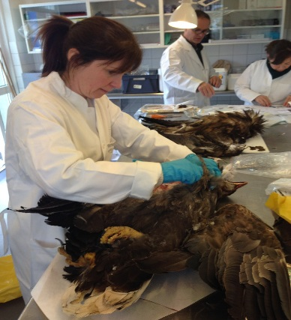
KeY activities: T1.3, 2.3. Months 12-48
Deliver a network of collaborating laboratories capable of delivering pan-European surveillance and monitoring
FIRST STEPS
Early wins on networks: AGF/PB/RM to develop concept of a poisoning network using existing labs
I STSM and I workshop potentially budgeted
Use as platform for wider development to engage and include non poisoning labs
List of overall labs and capabilities (including non-poisoning laboratories) and activities - explore potential to link with SETAC database at May meeting (RFS and NvdB to explore)

Slide 7
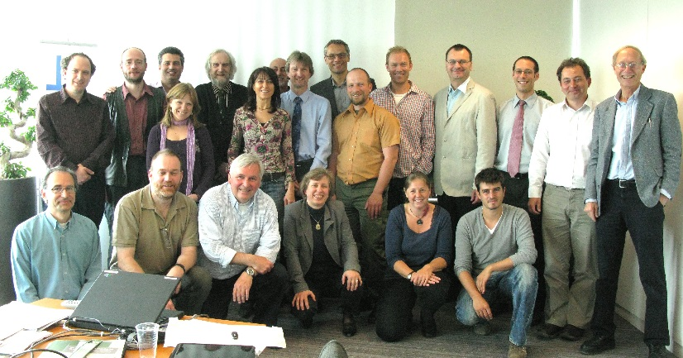
KeY activities: T1.5, 2.5. Months 30-48
Deliver training and guidance in pan-European surveillance and monitoring using raptors
Training School: Contaminant monitoring with raptors
NEXT STEPS
Development of a draft schema of activities that could be run
Led by AGF
Possibly bring SS into end of next FY (TBC)

