Slide 1
COST Reimbursement Rules
Svetlana Voinova – Ciudad Real – 19 February 2018

Slide 2
Meetings
Accept or Decline the invitation
Sign attendance list
Submit you claim online with relevant supporting documents
Claim Submission Deadline: 30 days

Slide 3
Reimbursement

Slide 4
Accommodation and Meals
Flat rates only ! No receipts
€120 per night
Maximum: Attended days + 1
€ 20 per meal
According to travel

Slide 5
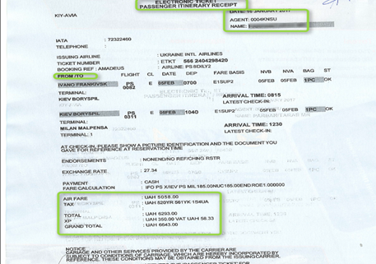
Travel expenses
Flight :
Economy
Max € 1200
Car :
Max 2000 km
€ 0.20 per km
Train, Bus, Ferry :
Cross-border
First or second class

Slide 6
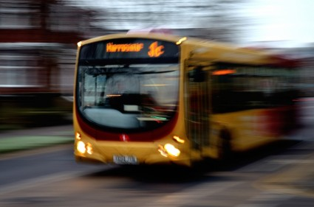
Local transport
Train, tram, metro, bus… (within one country)
25 EUR or less no receipts
More than 25 EUR - ALL receipts
Taxi
Max 80 EUR
No other means
10PM – 7AM

Slide 7
Other travel eligible expenses
Luggage fees
Parking fees
Entry visa fee

Slide 8
Non-eligible expenses
Registration, lecture fees and honoraria
Insurance (life, medical, health, luggage, etc.)
Fuel, road tolls and car rental
Charges for a rebooked travel ticket
Expenses associated with obtaining visas

Slide 9
How to submit your
Online Travel Reimbursement
Request (OTRR)

Slide 10
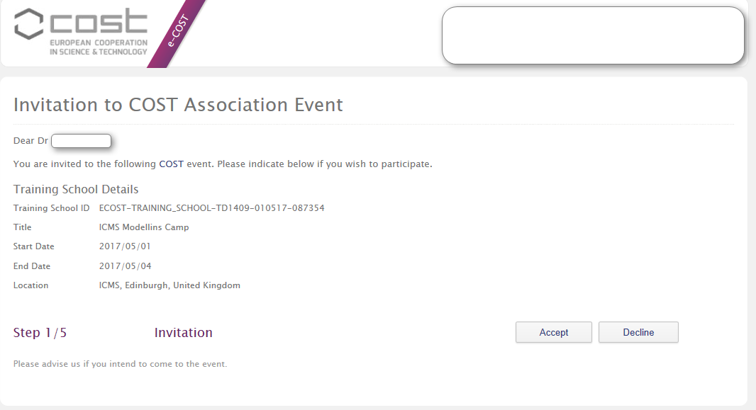
Step 1/5 Accept or Decline

Slide 11
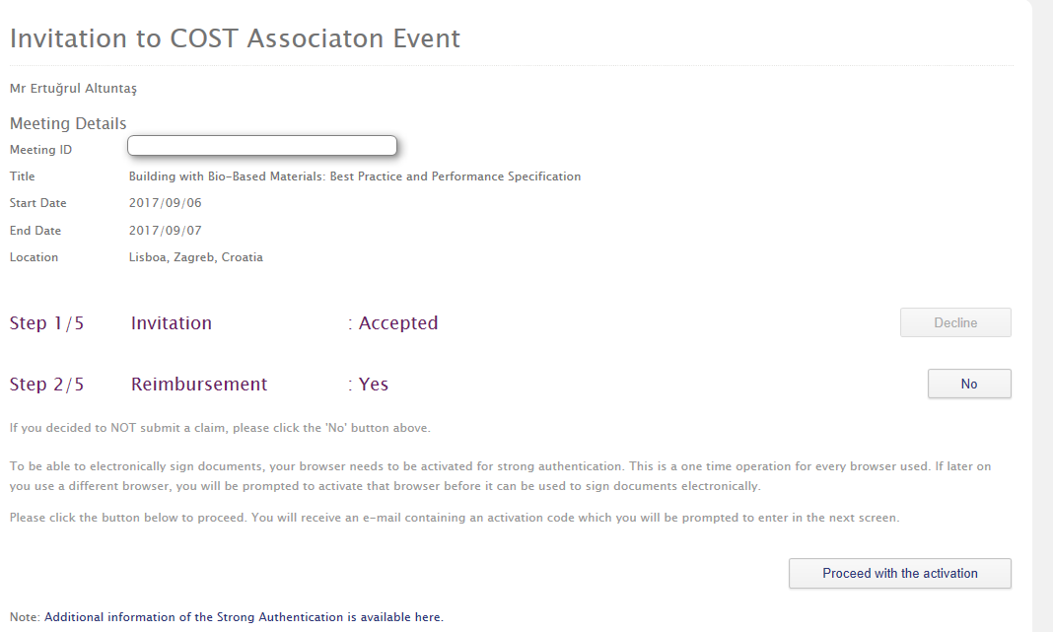
Step 2/5 Reimbursement?

Slide 12
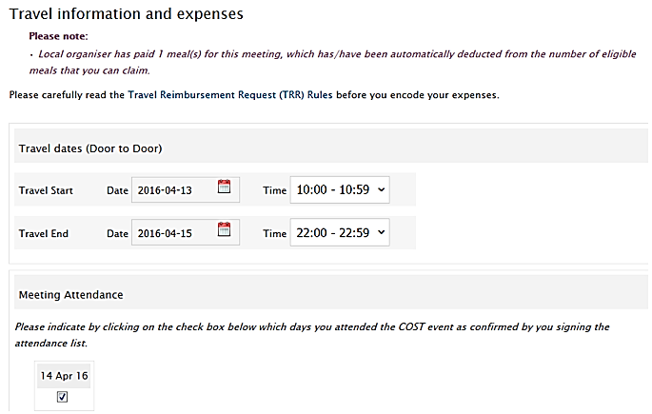
Step 3/5 Fill in your travel expenses

Slide 13
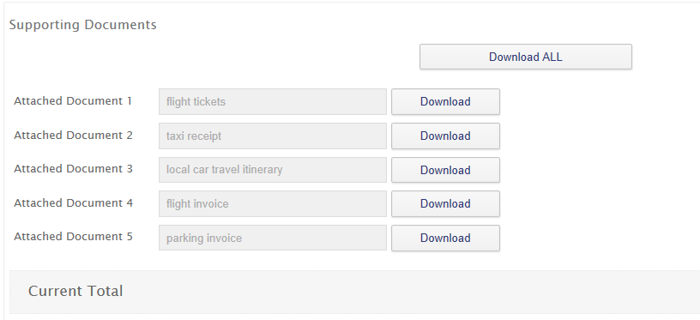
Upload receipts

Slide 14
Step 4/5 Select Bank account

Slide 15
Step 5/5 Submission

Slide 17
Thank you Svetlana.Voinova@cost.eu

