Slide 1
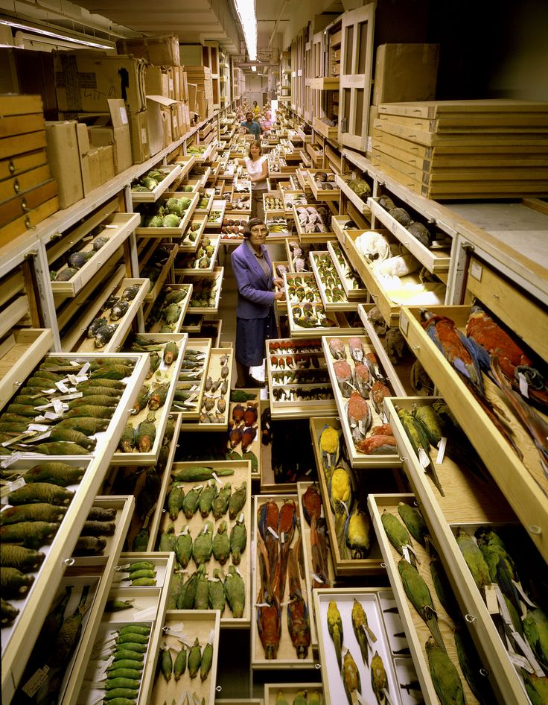


WORKING GROUP 3 COLLECTIONS ARENA
Paola Movalli, Chair WG3
1st GENERAL MEETING
Ciudad Real, 19th February 2018

Slide 2
Collections – Context
ESBs
  Few have raptor samples, recent years/decades only
  Designed for contaminant monitoring
  Potential for more ESBs to bank raptor samples
NHMs
  Large collections (skins, bones and eggs) from most regions of Europe, 18th century to modern times.
  Not designed for contaminant monitoring – but with new methods can extend contaminant monitoring over space and time
  Many NHMs also collect and store contemporary raptor samples.
Notes:
NHMs across Europe house large collections of raptor specimens, mostly skins, bones and eggs, originating from most regions of Europe, dating from the 18th century to modern times. While these collections were not designed to serve contaminant monitoring, these tissues can deliver data, particularly as analytical equipment and methods develop, to extend analysis of contaminant exposure over space and time. Additionally, some NHMs collect and bank contemporary raptor samples.
Complementing NHMs, there has been a steep rate of establishment of ESBs in recent decade. Samples held in ESBs (e.g. liver, kidney, muscle, adipose tissues, blood) are normally specifically gathered for contaminant monitoring and, like NHM specimens, allow extension of analysis of contaminant exposure over space and time. Several ESBs hold raptor samples and there is strong interest in others to do so, given the link to regulatory needs.
Few raptor collections in NHMs and ESBs are digitised but there is strong interest to achieve this. While Scientific Collections International (www.scicoll.org) links NHMs and the International ESB Group (www.inter-esb.org) links ESBs, there is no network specifically linking both NHMs and ESBs in order to make raptor specimens more visible and accessible for biomonitoring.

Slide 3
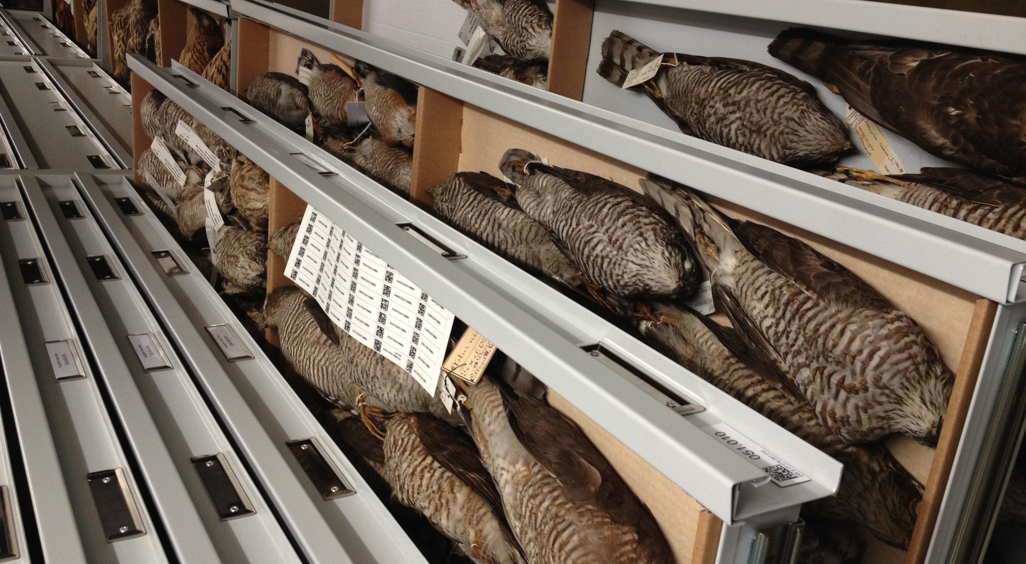
Raptor collections, Naturalis Biodiversity Center

Slide 4
WG3 Research Coordination Objective
Objective R2: To develop a framework for a distributed European Raptor Specimen Bank (ERSpeB) for contaminant monitoring.
  WHY
    Few existing raptor specimen collections made with contaminant monitoring in mind
    Collections designed to meet contaminant monitoring needs are national in scale (e.g. UK PBMS).
  WHAT?
    Develop ERSpeB framework to link and expand existing collections and, where appropriate, propose new regional collections, to meet ERBioMS needs.
Notes:
Existing raptor specimen collections in NHMs and ESBs have only in a very few cases been made with contaminant monitoring in mind; those collections which are designed to meet contaminant monitoring needs are national in scale (e.g. UK Predatory Bird Monitoring Scheme). There is therefore a need to develop an ERSpeB framework to link and expand existing collections and, where appropriate, propose new regional collections, to meet ERBioMS needs.

Slide 5
WG3 Capacity-building Objective
Objective C2: To build capacity in the ‘collections arena’ through networking and collaboration among ecotoxicologists and raptor collections (NHMs, ESBs, etc), including through:
  (a) constructing a meta-database of existing raptor specimens and of any existing related contaminant data, and stimulating digitisation of collections, to enhance access and use for contaminant monitoring;
  (b) stimulating expansion of raptor collections.
Notes:
Objective C2: To build capacity in the ‘collections arena’ through networking and collaboration among ecotoxicologists and raptor collections (NHMs, ESBs, etc), including through: (a) constructing a meta-database of existing raptor specimens and of any existing related contaminant data, and stimulating digitisation of collections, to enhance access and use for contaminant monitoring; (b) stimulating expansion of raptor collections. Construction of the database will involve developing standards for digital description and online publication of raptor samples and related data, and developing systems and protocols for web-based exchange, analysis and visualization (mapping) of these data.

Slide 6
WG3 - Expected Impact
a new strategic approach towards creation of a distributed European Raptor Specimen Bank to store the necessary samples to underpin prioritised pan-European assessments;
greatly enhanced knowledge of and access to these samples and to related contaminant data; and
better understanding on how to make best use of such samples.

Slide 7
WG3 links to other WGs
Collections Arena
  falls between Field Arena (WG4) and Analysis Arena (WGs 1 & 2)
  samples collected from field > stored in collections > used by labs
ERSpeB and metadatase of samples
  key resources for proposed ERBiomS being developed by Analysis Arena WGs 1&2.
  ERSamP (WG4) will be key source of new specimens for ERSpeB.
Interaction/discussion/coordination therefore vital, e.g. to:
  agree which species to prioritise, what contextual data required
  understand potential, needs and constraints of each Arena

Slide 8
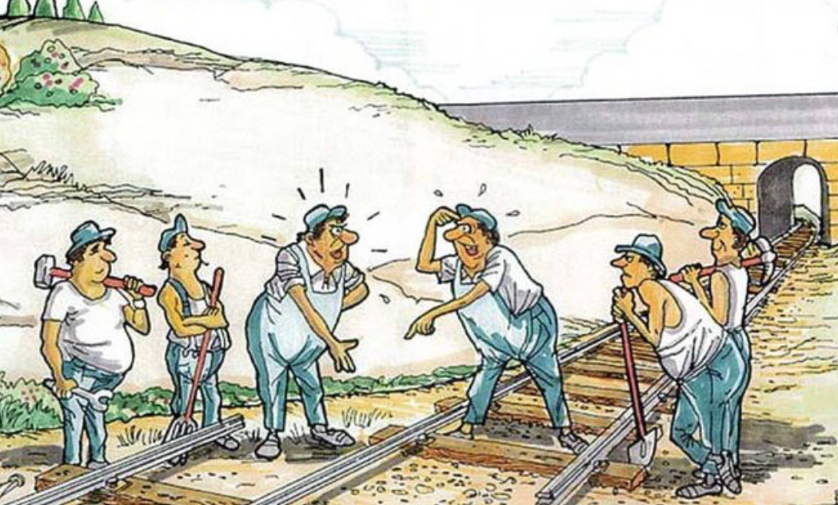
WHEN TEAMWORK DOESN’T WORK

Slide 9
Task 3.1
Review existing raptor collections in Europe, [Oct 2017 – Sep 2019], includes consideration of:
  existing collections;
  current collecting activities;
  storage facilities;
  current provision for research access to collections, samples exchange;
  constraints to collection, transport and storage of samples.
    D3.1 Report & peer reviewed paper on existing collections in Europe, constraints (Sep 2019]

Slide 10
Task 3.2
Develop framework for a distributed European Raptor Specimen Bank (ERSpeB) for contaminant monitoring [Oct 2018 – Sep 2020], includes consideration of:
  collecting priorities (in relation to needs of WGs1&2);
  potential for collections to accept new specimens from the field arena;
  sources for new specimens (in relation to WG3);
  storage needs;
  potential to establish new (regional) collections;
  enhanced provision for research access to collections;
  measures to resolve constraints to collection, transport, storage of samples.
    D3.2 Technical specs and peer-reviewed paper on ERSpeB framework. [Sep 2020]

Slide 11

‘Best-in-class’ processes and procedures

Slide 12
Task 3.3
  Design and construct a meta-database (linked to IPCheM) of existing raptor specimens and of any related contaminant data [Apr 2019-Jun 2021] involving:
  developing standards for the digital description and online publication of raptor samples and related data;
  developing systems and protocols for web-based exchange, analysis and mapping of this data;
  stimulating digitisation of collections.
    D3.3 Meta-database of raptor specimens, linked to IPCheM. [Jun 2021]

Slide 13
Task 3.4
Develop guidance on using raptor specimens in collections for biomonitoring [Apr 2020 – Jun 2021]
    D3.4 Guidance on use of NHM and ESB collections for contaminant monitoring [Jun 2021]

Slide 14
Milestones WG3
Workshop: workplanning– tomorrow
3 STSMs – to advance tasks
Workshop: ERSpeB framework (by April 2019)
3 workshops: development of meta-database and guidance (by Sep 2019, April 2020, Jan 2021)
joint training school with WG 4 (by Dec 2020)
We can adjust these milestones/activities as necessary, e.g. if need other missions or workshops.

Slide 15
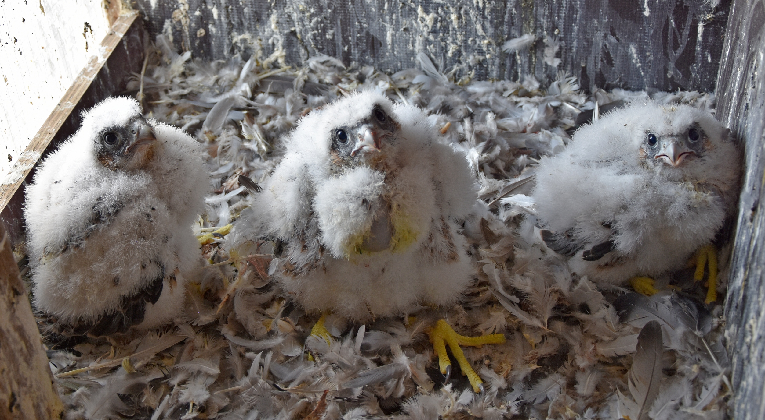
THANK YOU

