Slide 1
Work Groups (WG) 1 & 2
Richard Shore, Igor Eulaers (WG1)
Antonio Garcia-Fernandez, Rafael Mateo (WG2)

Slide 2
WHY MONITOR?
Detect environmental hazard
Understand nature and drivers of trends (time/ space)
Assess risk and need for intervention
Validate fate and assessment models
Assessment of mitigation
Evidence regulation working
Notes:
I will present some the approaches used in CEH for risk assessment of metals in soils (with a little on surface waters). CEH brings specific skills, centred around understanding of the processes of metal speciation and metal bioavailability, to metals risk assessment. We can apply these skills to both retrospective risk assessment (of currently contaminated environments) and to prospective risk assessment (by predicting future contamination using models).

Slide 3
Population level impacts oF pollutants

Slide 4
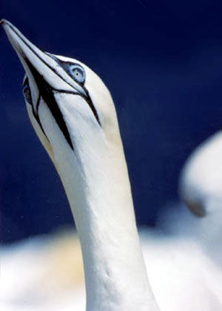
BDEs: MITIGATION AND EXPOSURE
POLICY RELEVANCE: REACH, Stockholm convention, ACHS position paper, EA European lead for BDE209
Scrutiny under RoHS
Newton Aycliffe closes
Dumping at sea banned
PeBDE & OBDE banned
Fire safety law FFFRS
Crosse et al., 2012 Environmental Pollution
Notes:
4

Slide 5
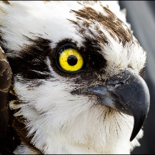
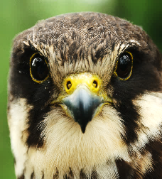
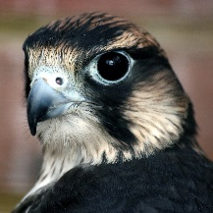
Why use raptors for chemical monitoring?
Most predators
Predatory Birds
Multiple food chains
Integrators
Apex species
Eggs and tissues
Populations sensitive
May use other matrices for inorganic compounds
Sentinels
Rare species
Relatively easy to sample (incl. non-destructively)
Charismatic
Notes:
Left hand column

Slide 6
WG1 and WG2 – key objectives
WG1&2 address research coordination (RC) and capacity building (C) objectives R1 and C1
Objective R1: To assess current capacities for pan-European raptor biomonitoring and develop a framework for a European Raptor Biomonitoring Scheme (ERBioMS)
Focus on current capabilities to detect temporal and spatial trends in contaminant exposure and key areas of weakness (in the absence of coordination).
Develop an ERBioMS framework capable of delivering pan-European surveillance and monitoring of key pollutants (EU chemicals law and relevant global and regional conventions.

Slide 7
WP1 and WP2 – key objectives
WG1&2 address research coordination and capacity building objectives R1 and C1
Objective C1: build capacity in the ‘analysis arena’ through networking and collaboration among ecotoxicologists, collaborating laboratories and regulators
Collaborative work on objective R1
Piloting joint assessment and reporting (deliver proof of concept)
Develop guidance on how to integrate assessments with those of relevant regulatory bodies (e.g. ECHA, EFSA, UNEP)….…ie explore how to mesh with key stakeholders needs

Slide 8
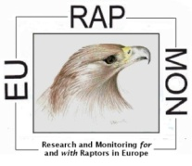
BUILDING ON EURAPMON LEGACY
Inventory of current monitoring - contaminants, species, matrices (Gomez-Ramirez et al. 2014)
Inventory of which raptor species are being monitored (Vrezec et al 2012)
Identified best sample types and methods for monitoring different compounds (Espin et al. 2016)
Notes:
I will present some the approaches used in CEH for risk assessment of metals in soils (with a little on surface waters). CEH brings specific skills, centred around understanding of the processes of metal speciation and metal bioavailability, to metals risk assessment. We can apply these skills to both retrospective risk assessment (of currently contaminated environments) and to prospective risk assessment (by predicting future contamination using models).

Slide 9
Why two Working groups?
WG1 focuses on REACH ‘priority contaminants such as Hg and Pb, and engages in particular REACH, Minamata (Hg) and Convention on Migratory Species (Pb) stakeholders
WG2 focuses on PPPs, biocides and NSAIDs and engages stakeholders in EU PPP, Biocides and Medicinal Products law
Tasks divided as involve different contaminants and hence different laws/policies, agencies (WG1 is largely ECHA-related, WG2 largely EFSA-related) and, sometimes, researchers
WGs will work closely together
common approaches
read-across (between types of compounds)
share ideas and methodologies

Slide 10
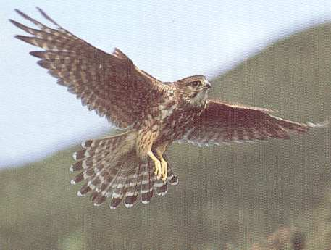
BEYOND STATE OF THE ART
Assessing current capacities for pan-European assessment of contaminant exposure
Linking researchers and analytical laboratories (in academia and industry),
Developing an ERBioMS framework
Pilot framework (pan-European assessment and reporting of trends in exposure (- where feasible, effects)
Providing guidance on integration with regulatory risk assessments and effectiveness evaluations

Slide 11
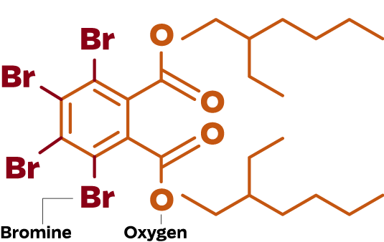
KeY activities: T1.1, 2.1. Months 1-24
Assess current capacities for pan-European raptor biomonitoring (assessment of exposure trends and, where feasible, effects) for 4-6 prioritised contaminants
Candidate contaminants (to be discussed tomorrow) could include:
PCBs, FRs and PFs
Toxic metals (Hg, Pb)
PPPs-neonicotinoids
Biocides (SGARs)
Parasiticides, NSAIDs and livestock antibiotics

Slide 12
KeY activities: T1.2, 2.2. Months 18-36
Develop framework for European Raptor Biomonitoring Scheme
(ERBioMS) using priority species and matrices
Identify appropriate species (and read across methods for species within trophic guilds)
Identify sample matrices based on Espin et al 2016
Identify scientific methodology
Relate to WG3 and WG4 (logistics)

Slide 13
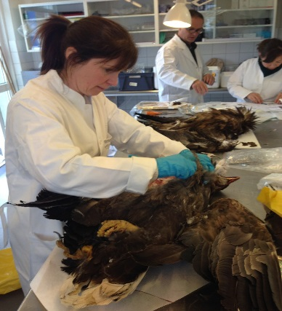
KeY activities: T1.3, 2.3. Months 12-48
Deliver a network of collaborating laboratories capable of delivering pan-European surveillance and monitoring
Develop an agreed list of priority compounds/compound groups
Assess potential for monitoring using species and matrices selected by task
Establish the scope of activities that could be undertaken and timeliness, quality control and potential for sample exchange between laboratories and collections

Slide 14
RED KITES AND SGARs
Data from 4 different labs now brought together into collaborative annual report
Challenging as all have different operating procedures
Just bringing data together can be technically difficult
Case study to build on?
http://pbms.ceh.ac.uk/sites/pbms.ceh.ac.uk/files/PBMS_Rodenticide_Red_Kite_2015_FINAL.pdf

Slide 15
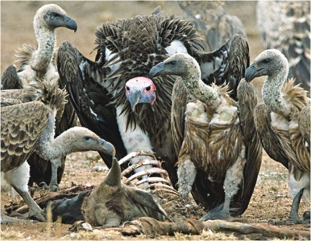
KeY activities: T1.4, 2.4. Months 36-42
Carry out pilot joint assessments and reporting for proof of concept
Post-mortem collation of data including visceral gout
Poisoning network
Key chemical monitoring
Relate to WG3 and WG4 (logistics)

Slide 16
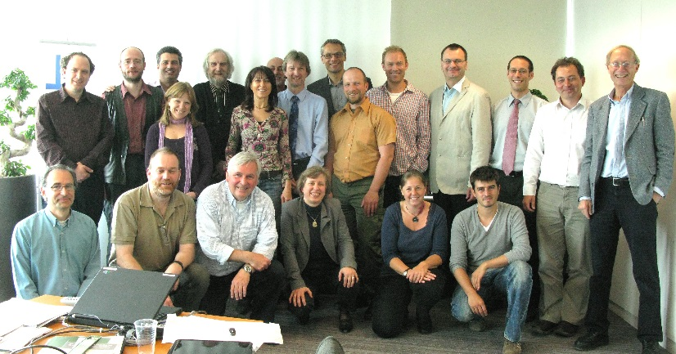
KeY activities: T1.5, 2.5. Months 30-48
Deliver training and guidance in pan-European surveillance and monitoring using raptors
Refine technical specs for ERBioMS, for assessment of priority contaminants, PPPs etc
Training School: Contaminant monitoring with raptors
Development, with key stakeholders, proof of concept reporting frameworks

