Slide 1
Scientific EU assessment of pesticides and possible EFSA contributions to the ERBFacility
Dr Jose V. Tarazona
Head Pesticides Unit
European Food Safety Authority

Slide 2
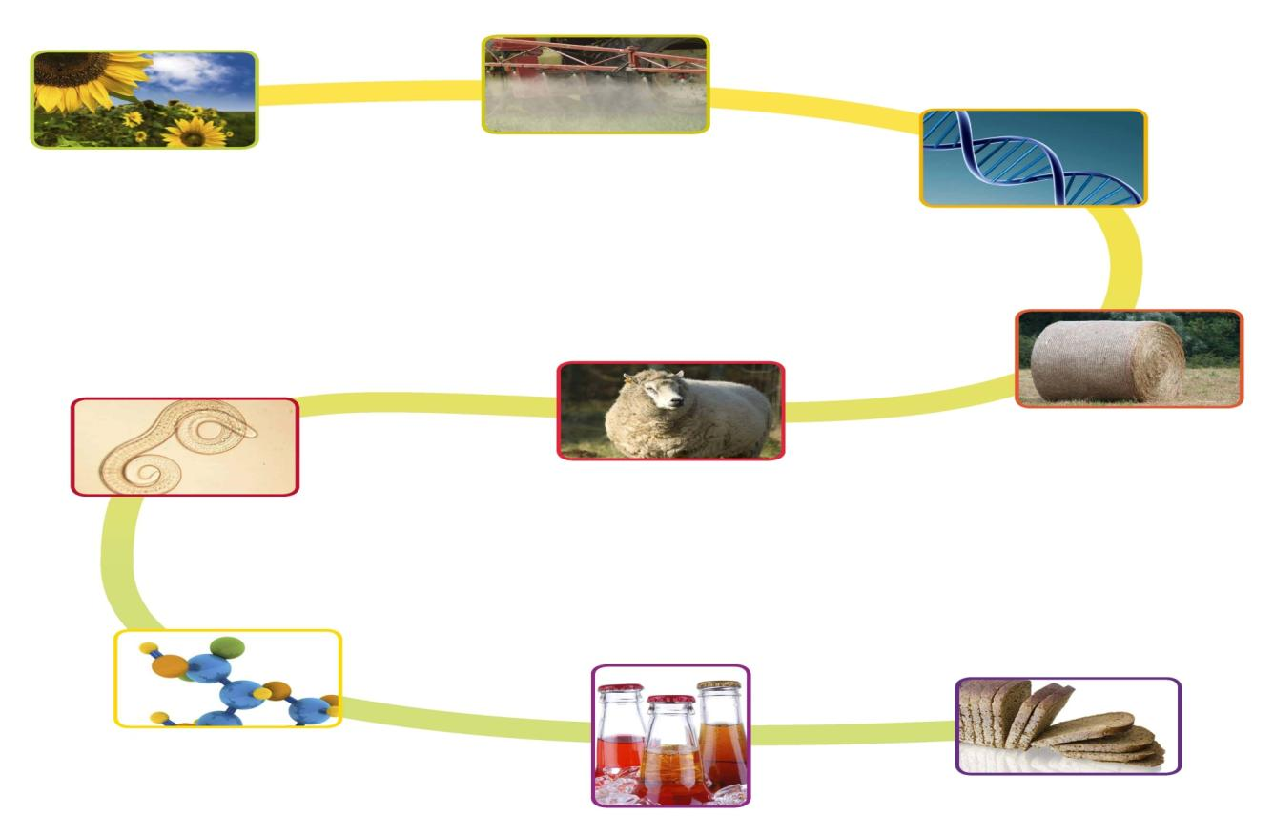
Plant Health
Plant Protection
Genetically modified
organisms
Animal health
and welfare
Animal feed
Biological
hazards
Nutrition
Chemical
contaminants
Food
additives
Food
packaging

Slide 3
Plant Health
Plant Protection
Genetically modified
organisms
Animal health
and welfare
Animal feed
Biological
hazards
Nutrition
Chemical
contaminants
Food
additives
Food
packaging

Slide 4
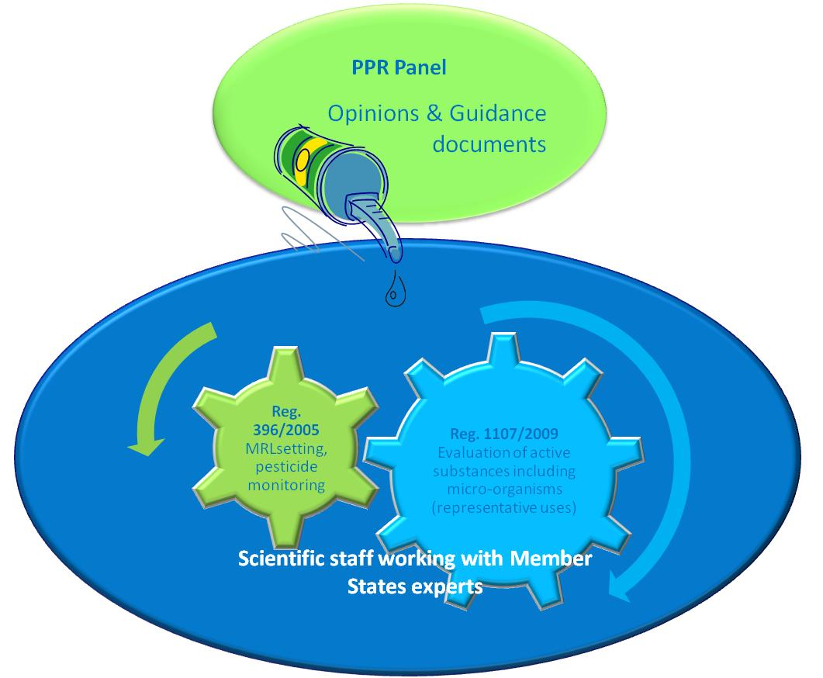
Scientific consistency: PPR key role
General Scientific assessment:
Opinions & Guidance
Dossier specific assessment:
Conclusions
MRL Reasoned opinions

Slide 5
EXAMPLES OF Relevant activities
Possible contributions TO EFSA
Update of the EFSA Guidance Document on the risk assessment of birds and mammals
  Risk assessment scheme for raptors
    Model development and validation
  Design of post-marketing monitoring schemes
Regular contribution to EFSA public consultations on pesticides and other chemicals
  We launch around 4 consultations/month, most are on renewals of authorised pesticides
    Your data on specific pesticides would be highly appreciated

Slide 6
EFSA Guidance Birds and Mammals
BIOMAGNIFICATION MODELLING
EFSA, 2009. Guidance Document on Risk Assessment for Birds and Mammals. EFSA Journal 7(12): 1438.

Slide 7
Needs for monitoring WITH raptors in guidance development
Developing exposure scenarios
  Pesticide levels in different species
  Spatial and temporal variability
  Biology and ecology of the monitored species
Identification of chemicals with potential for biomagnification
  Chemical properties and QSARs
  Principles for B assessment in raptors
Internal levels
Habitat, diet,
environmental levels
or pesticide use
Estimated exposure

Slide 8
Needs for monitoring WITH raptors in substance assessment
Post-marketing vigilance
  Measured pesticide levels to be compared with premarketing estimations
Identification of unexpected hazards or effects
  Diagnostic tools
Eco-epidemiological studies
  Information on exposure (e.g. TK/TD models)
Highly relevant for guidance development and assessment of specific pesticides
Internal levels
Habitat, diet,
environmental levels
or pesticide use
Estimated exposure

Slide 9
Examples of Relevant activities
Possible contributions FROM EFSA
Information on pesticides
  All pesticides assessed in the EU (approved and non-approved)
  Three levels
    List of validated endpoints covering
    Summaries for all relevant studies
    Full study reports
Methodology for risk assessment
  Assessing effects
    E.g. TK/TD and population modelling
  Linking prospective and retrospective assessments
  New EFSA initiative for Landscape assessment

Slide 10
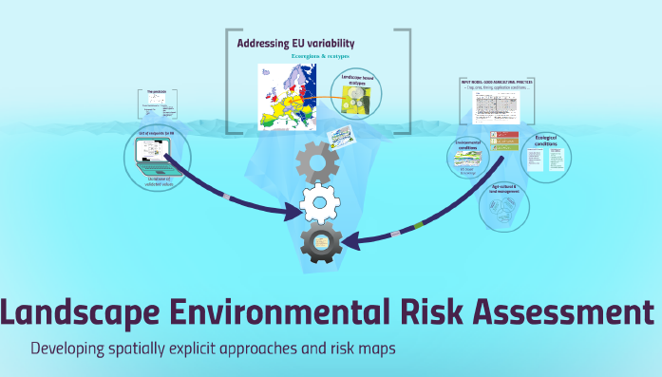
LANDSCAPE ENVIRONMENTAL ASSESSMENT
Spatial explicit risk maps addressing EU environmental variability

Slide 11
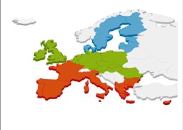
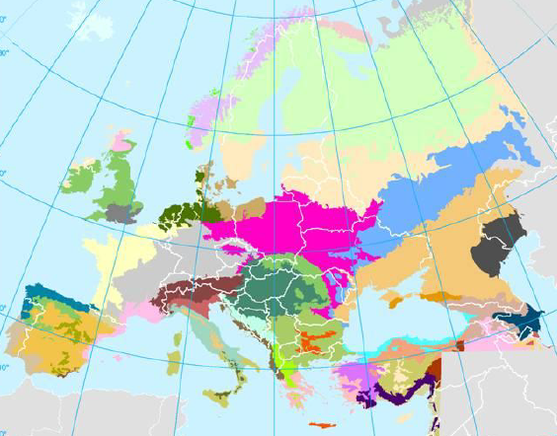
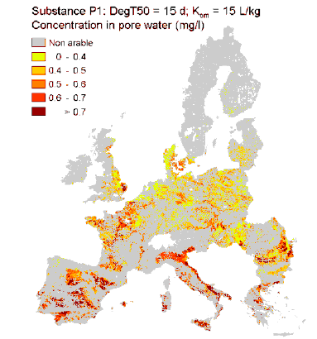
Final Goal: From generic scenarios to mapping risks
Moving to landscape based mapping for:
Protection goals
Risk assessment
Risk management options
Environmental and ecological conditions
+
Land use (crop dist.)
=
Agro-ecoregions and landscape ecotypes
Agro-ecoregions and landscape ecotypes
+
GAPs and use patterns
=
Mapping risks at EU level
(individual substance and cumulative)

Slide 12
PROBLEM FORMULATION
Regulatory Risk Assessment
Environmental impact contribution
CONCEPTUAL MODEL
INTENDED GAP
(per crop)
ENVIRONMENTAL PROFILE
(intrinsic properties)
ACTUAL USES
(per region)
In-crop -- Edge of field
Regional ---- Continental
Exposure
during application
Exposure
after
application
ADAPTED FOR EACH NON-TARGET GROUP
Seasonal
Long-term
Effects of individuals
f(time/dose/response)
Aggregated exposure/
time/
response
Effects of populations
f(landscape/exposure/structure)
Aggregated impact
population
Risk assessment outcome
Aggregated impact
Ecosystem Services
Long-term
Impact ES and biodiversity
Contribution from
other stressors

Slide 13
Possible IMPLEMENTATION
EFSA participation in COST actions
Observer in the Action Management Committee (MC) (without voting rights)
Participate as Working Group Member (upon decision by the Action’s Management Committee)

Slide 14
Other possibilities for cooperation
Additional options
Seconded National Experts
  6 months to 3 years sharing EFSA expertise
Guess scientist and study visit
  Short visit, e.g.
    For understanding the risk assessment methodology
    For extracting data from EFSA dossiers
Grants
  Funding organisations for supporting EFSA activities
  Limited to organisations nominated by MS

Slide 15

Thank you
3rd EFSA Scientific Conference
September 2018, Parma, Italy

