Slide 1
Some reflections in relation to ERBFacility
Peter Korytar, DG Environment
19 February 2018, Ciudad Real

Slide 2
ERBFacility in the policy context
Implementation and effectiveness evaluation of the EU chemical acquis
REACH, PPPR, BPR, Medicinal Reg., ….
7th EAP, Art. 71 (4) ….a chemical exposure and toxicity knowledge base will be established
Non-toxic environment
Early warning system
Lack of knowledge on the effect of chemicals on ecosystems
Notes:
·

Slide 3
Selection of substances to be monitored
One criterion to consider: Can we do anything about the exposure?
PCBs ?
PBTs/vPvBs – what about P/vP or close to PBTs/vPvBs ?
Prioritisation exercise
EHB4EU has one; maybe something simpler?
Notes:
·

Slide 4
Combination effects of chemicals
Allow for the assessment of combination effects of chemicals
E.g. record that chemicals were measured in the same individual
Notes:
·

Slide 5
Possible synergies
Consider synergies whenever possible and useful:
EHBM4EU
WFD Watch list
LUCAS – soil survey
Pollinators initiative
Notes:
·

Slide 6
Make data available
Make data available at least for the policy and regulatory work as soon as feasible
Notes:
·

Slide 7
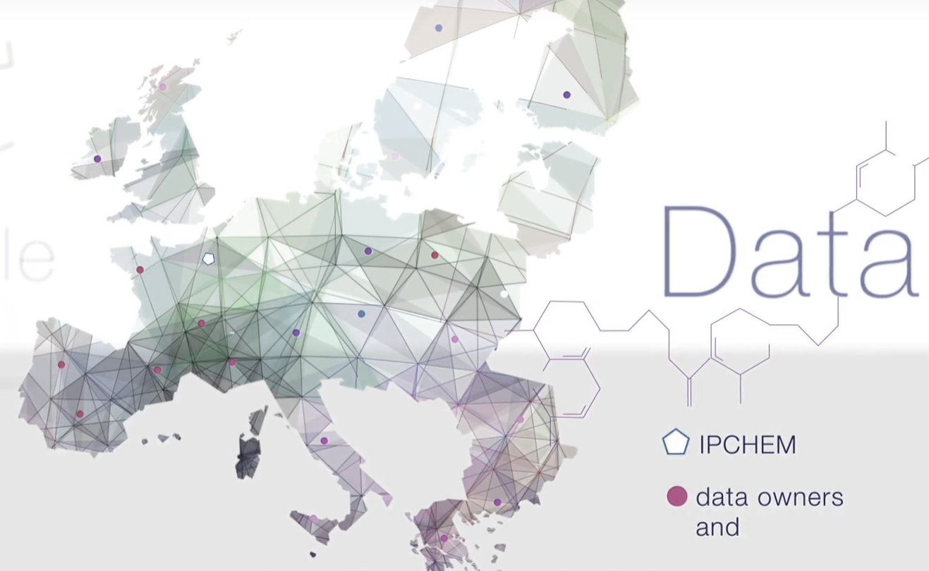
IPCHEM
Access point for discovering, accessing and retrieving chemical occurrence in various media across the world
Distributed
infrastructure
but also offers hosting facilities for orphan and research data
Facilitates access and provide hosting facilities
Improves data quality and comparability
Facilitates assessment
Streamlines reporting

Slide 8
IPCHEM data providers and users
Data providers | Users
Commission Services | Commission Services
EU Agencies | EU Agencies
Member States | Member States
International organisations | International organisations
National organisations | National organisations
Researchers | Researchers
 | General public

Slide 9
IPCHEM data policy
Data retrievable through IPCHEM shall be made available to all users at highest possible level of data granularity and under the conditions of free, full, open and timely access
Restrictions to the general rule
Level of data to which users have access | IPCheM User Groups
 | 1. EU Commission and Agencies | 2. EU National Bodies | 3. General Public
a. Metadata | Yes | yes | yes
b. Aggregated data | Yes | To be specified | To be specified
c. Filtered or generalised single measurement data | To be specified | To be specified | To be specified
d. Single measurement data | To be specified | To be specified | To be specified
Research project groups

Slide 10
Benefits of IPCHEM
Improves
Risk assessment; Prioritisation of chemicals; Validation of exposure and deposition models; Policy effectiveness evaluation; State of environment evaluation
Enables
Risk assessment of combination effects; Early warning system; Alert system between environment and food; Correlation assessments
Saves
Resources for data collections and data storing; Burden for reporting;

Slide 11
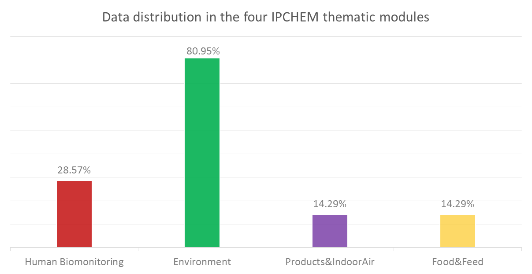
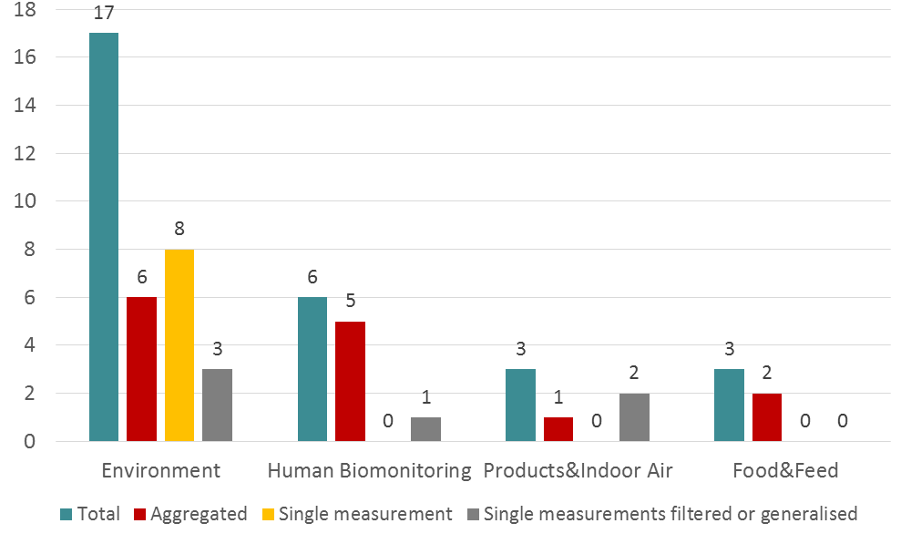
Current status
33.000.000 MEASUREMENTS
2040 SUBSTANCES
28 DATA COLLECTIONS
Full compliance with agreements and legislation (INSPIRE, personal data protection legislation)

Slide 12
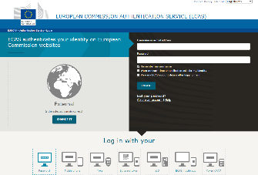
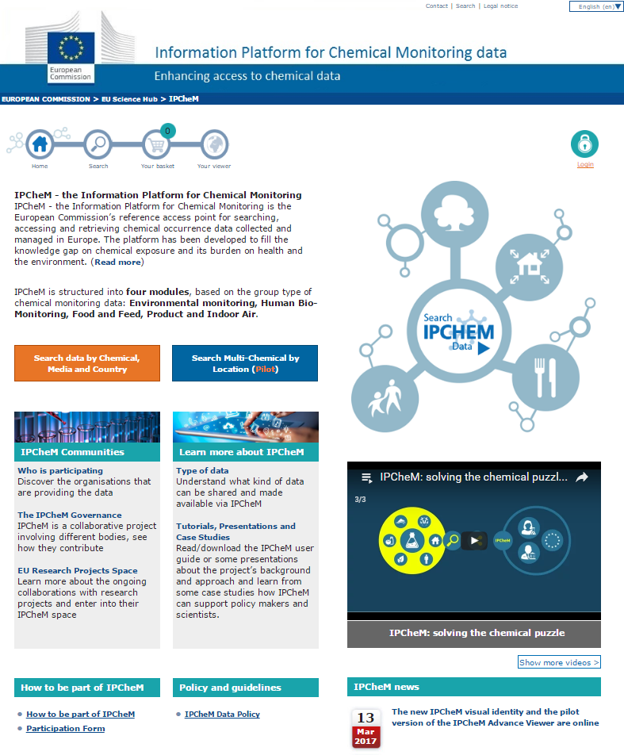
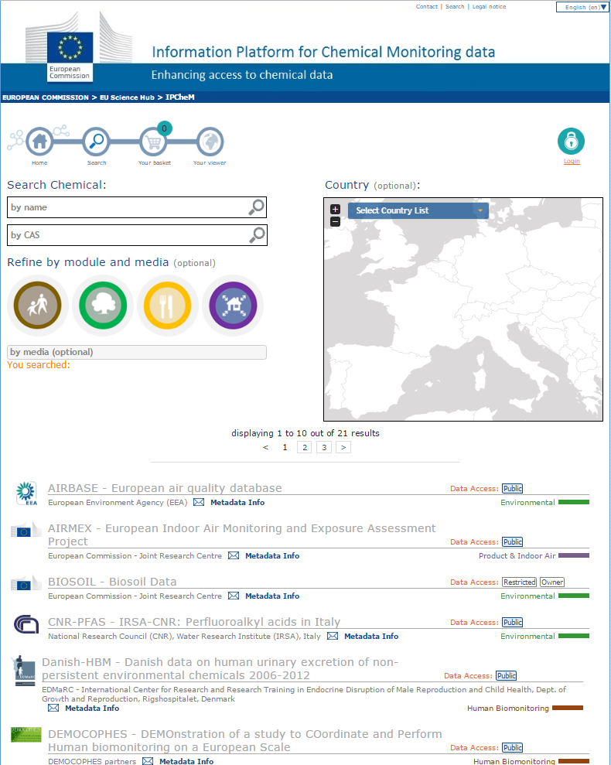
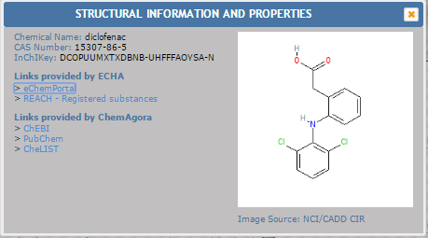
Main tools
EU login
Home page
Search by chemical
Link to Structural and Information PROPERTIES ChemAgora Service

Slide 13
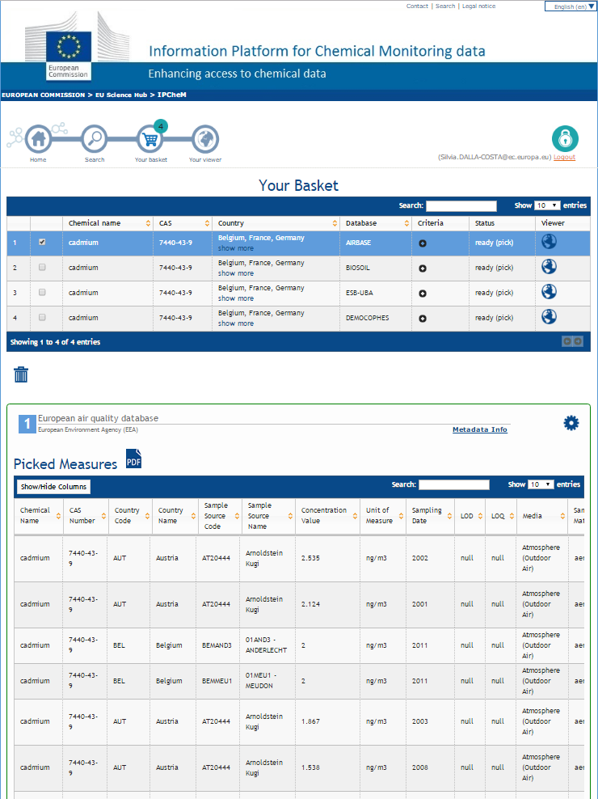
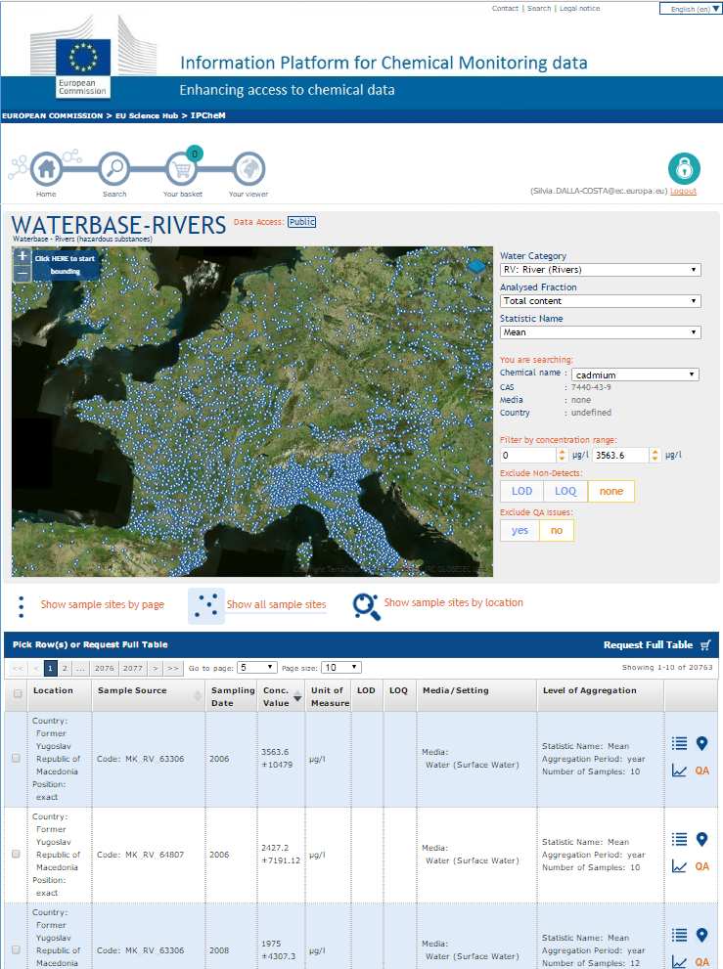
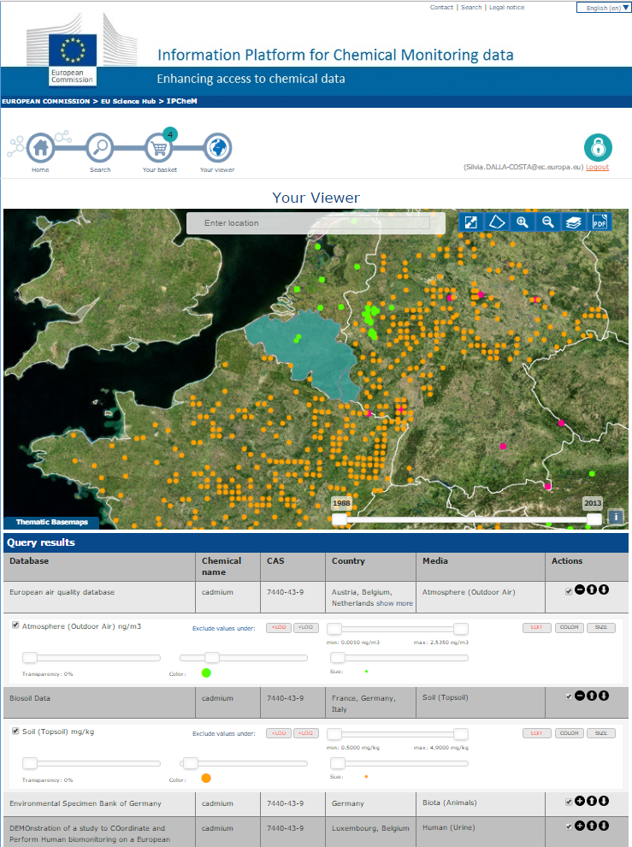
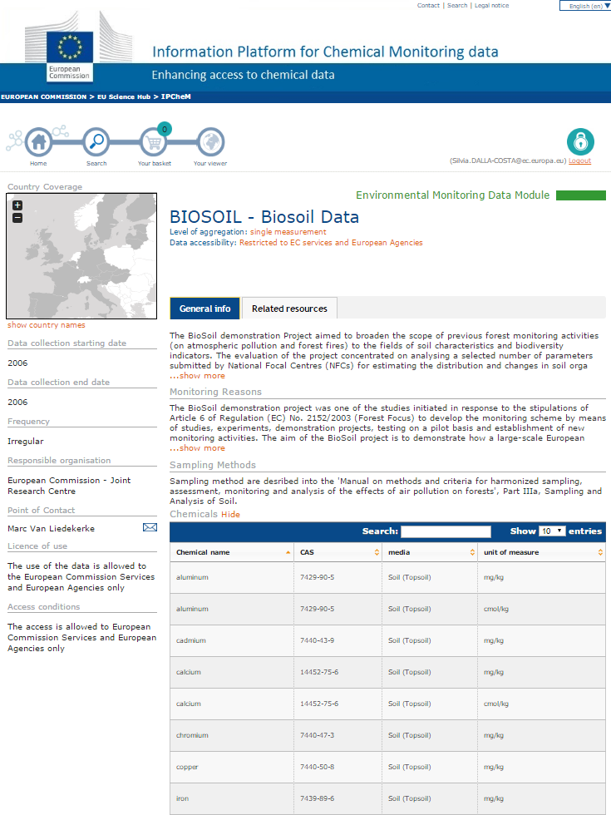
Basket tool
Main tools
DB Console
Search by chemical
Map viewer
Metadata page

Slide 14
IPCHEM is partnership
European Commission
DGs ENV, SANTE, RTD, JRC
Policy Coordinator: ENV
Policy Board: ENV, SANTE, RTD, JRC
Scientific & Technical coordinator: JRC
European Agencies:
EEA, EFSA, ECHA
Environment
International organisations:
OECD, Health Canada
Products & indoor air
JRC
EU Member States:
National monitoring
programmes/activities
Food & feed
Research projects
Humans
Notes:
IPCheM is based on strong strategic partnerships at EU level and beyond.
Within the EU Commission we have several partners: DG ENV is the Policy Coordinator and member of the Policy Board. DG SANTE, DG RTD are members of the Policy Board. DG JRC is member of the Policy board and it is the Scientific and Technical coordinator of the project.
Three EU agencies are partners of the IPCHEM projects: EEA, EFSA and ECHA. EEA is responsible for HBM and Environmental modules. EFSA is responsible for the Food and Feed module. The fourth module on Product & Indoor air is coordinated by our Unit.
At international level we currently have partnerships with OECD and Health Canada.
We also collaborate with several National monitoring programmes/activities and EU funded projects.

Slide 15
Thank you for your attention

