Slide 1



European Raptor Biomonitoring Facility
Guy Duke, Chair ERBFacility
1st GENERAL MEETING
Ciudad Real, 19th Februray 2018

Slide 2
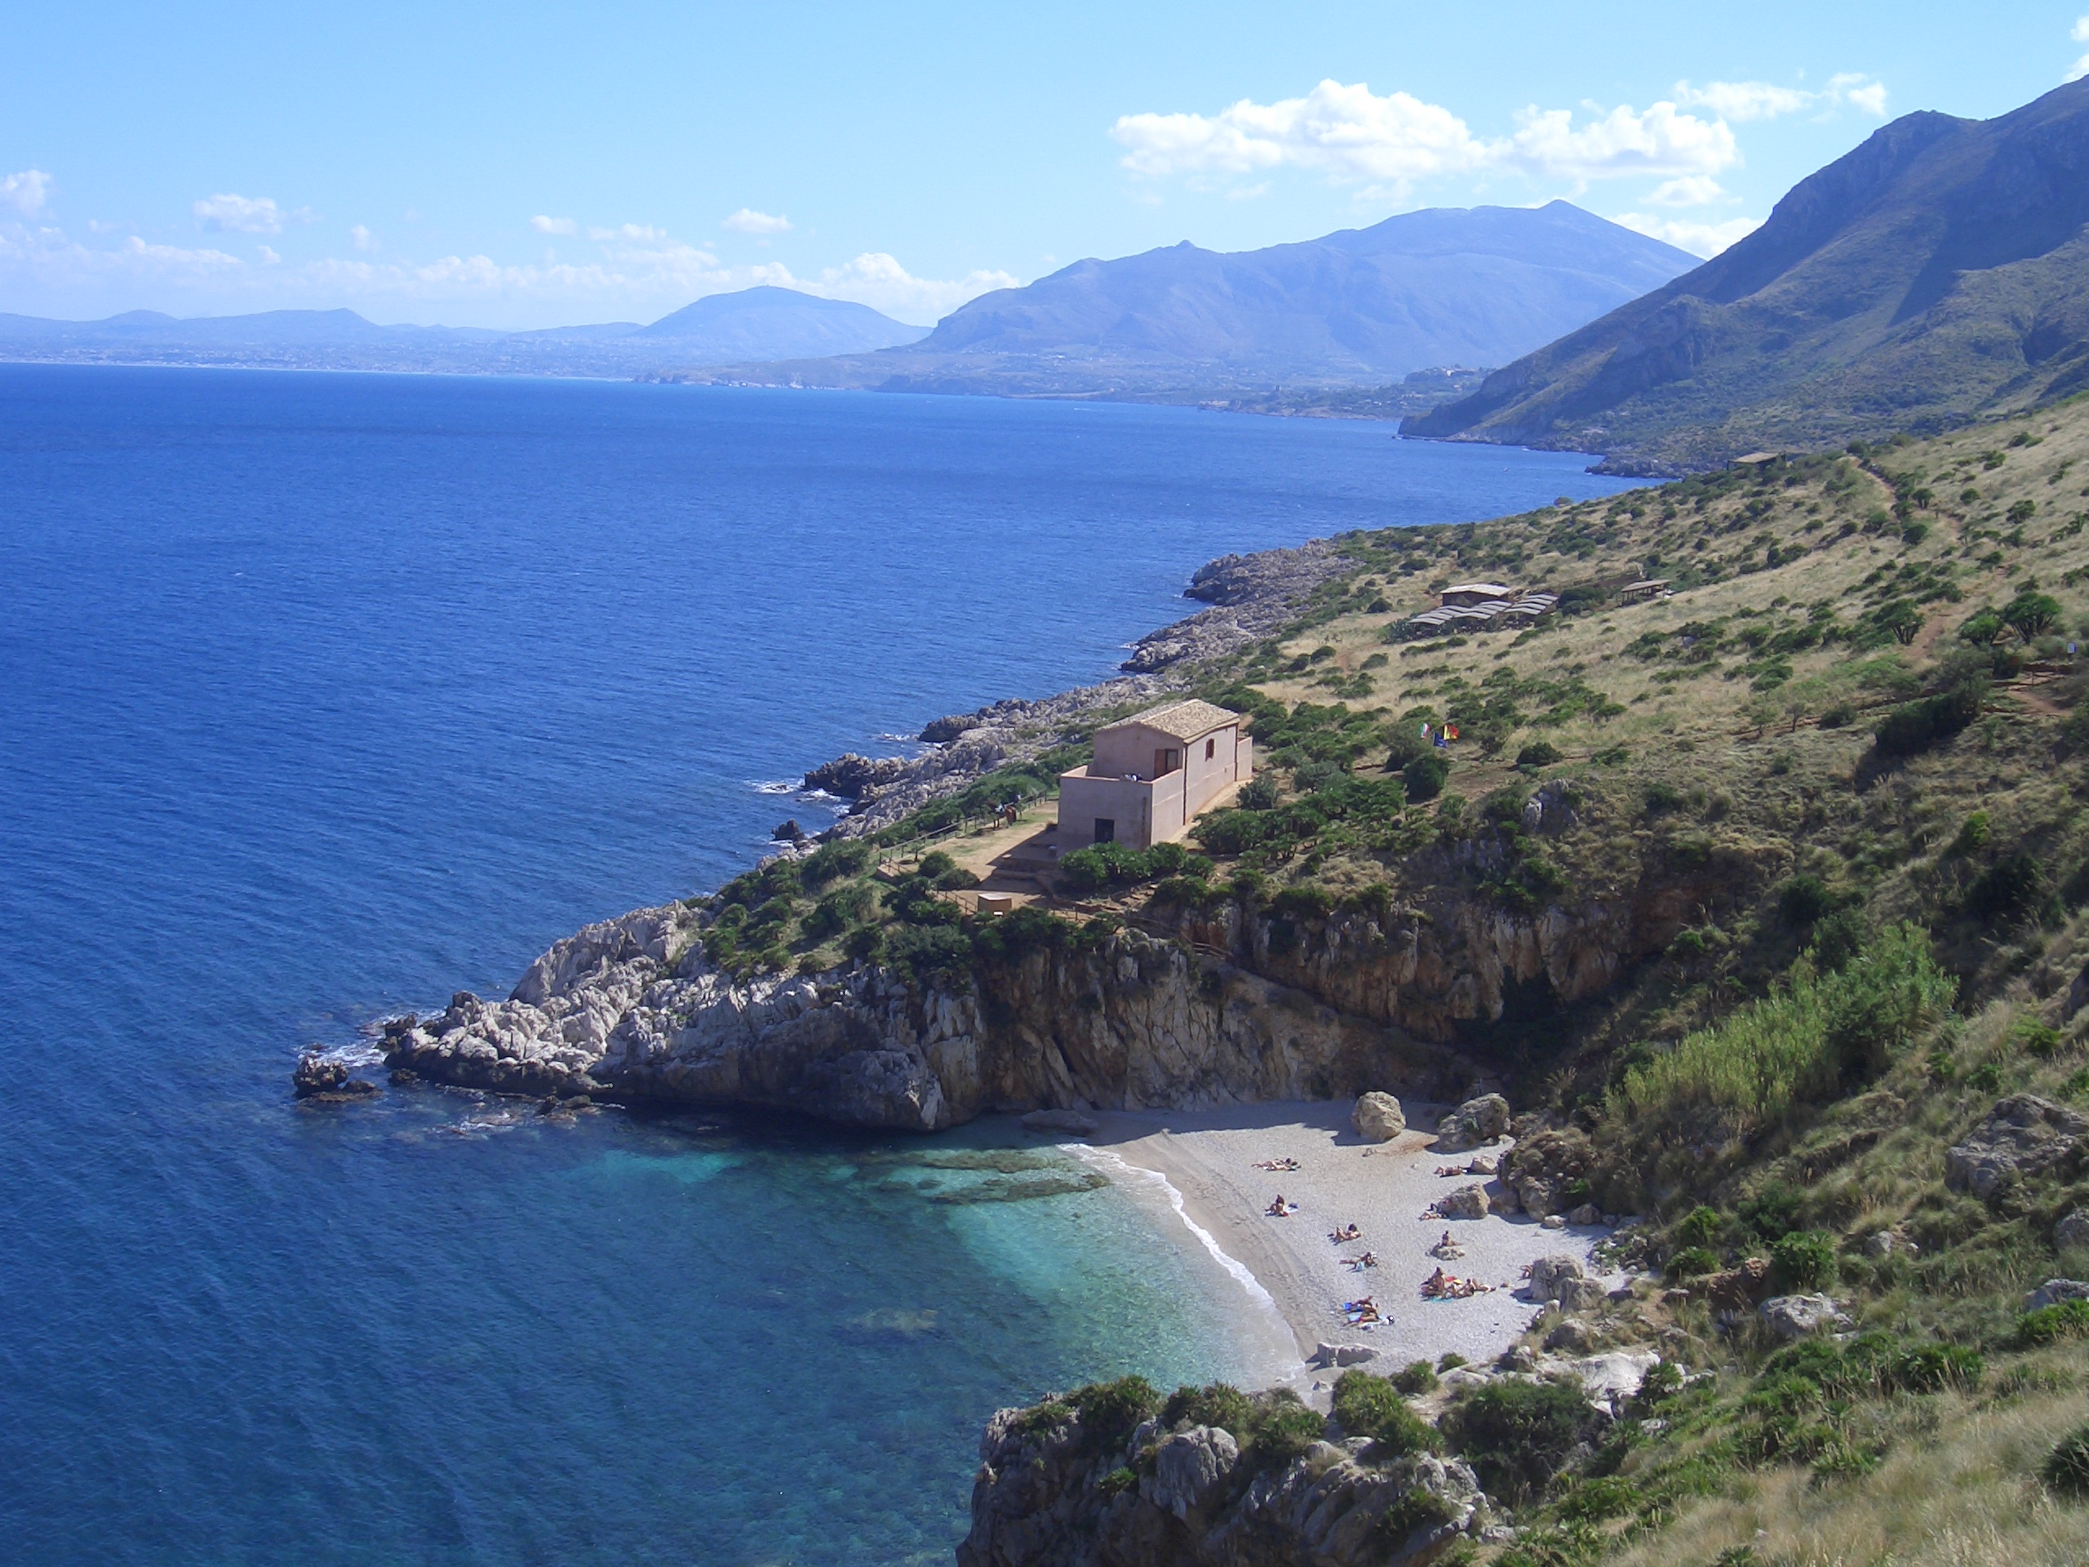


A little history
Workshop, Scopello, Sicily 2006
Special Issue Ambio 2007
EURAPMON proposals 2007/08
EURAPMON 2010-15 (ESF, c.€500k)
  Network – ecotoxicologists, ornithologists
  Inventory – raptor monitoring in Europe
  Reviews – monitoring for, monitoring with raptors
  Papers – e.g. what samples types to use
  Protocol – contaminant monitoring with raptors
  Acrocephalus 2017
ERBFacility proposals Feb & Dec 2016
ERBFacility 2017-21 (COST, c.€600k)

Slide 3
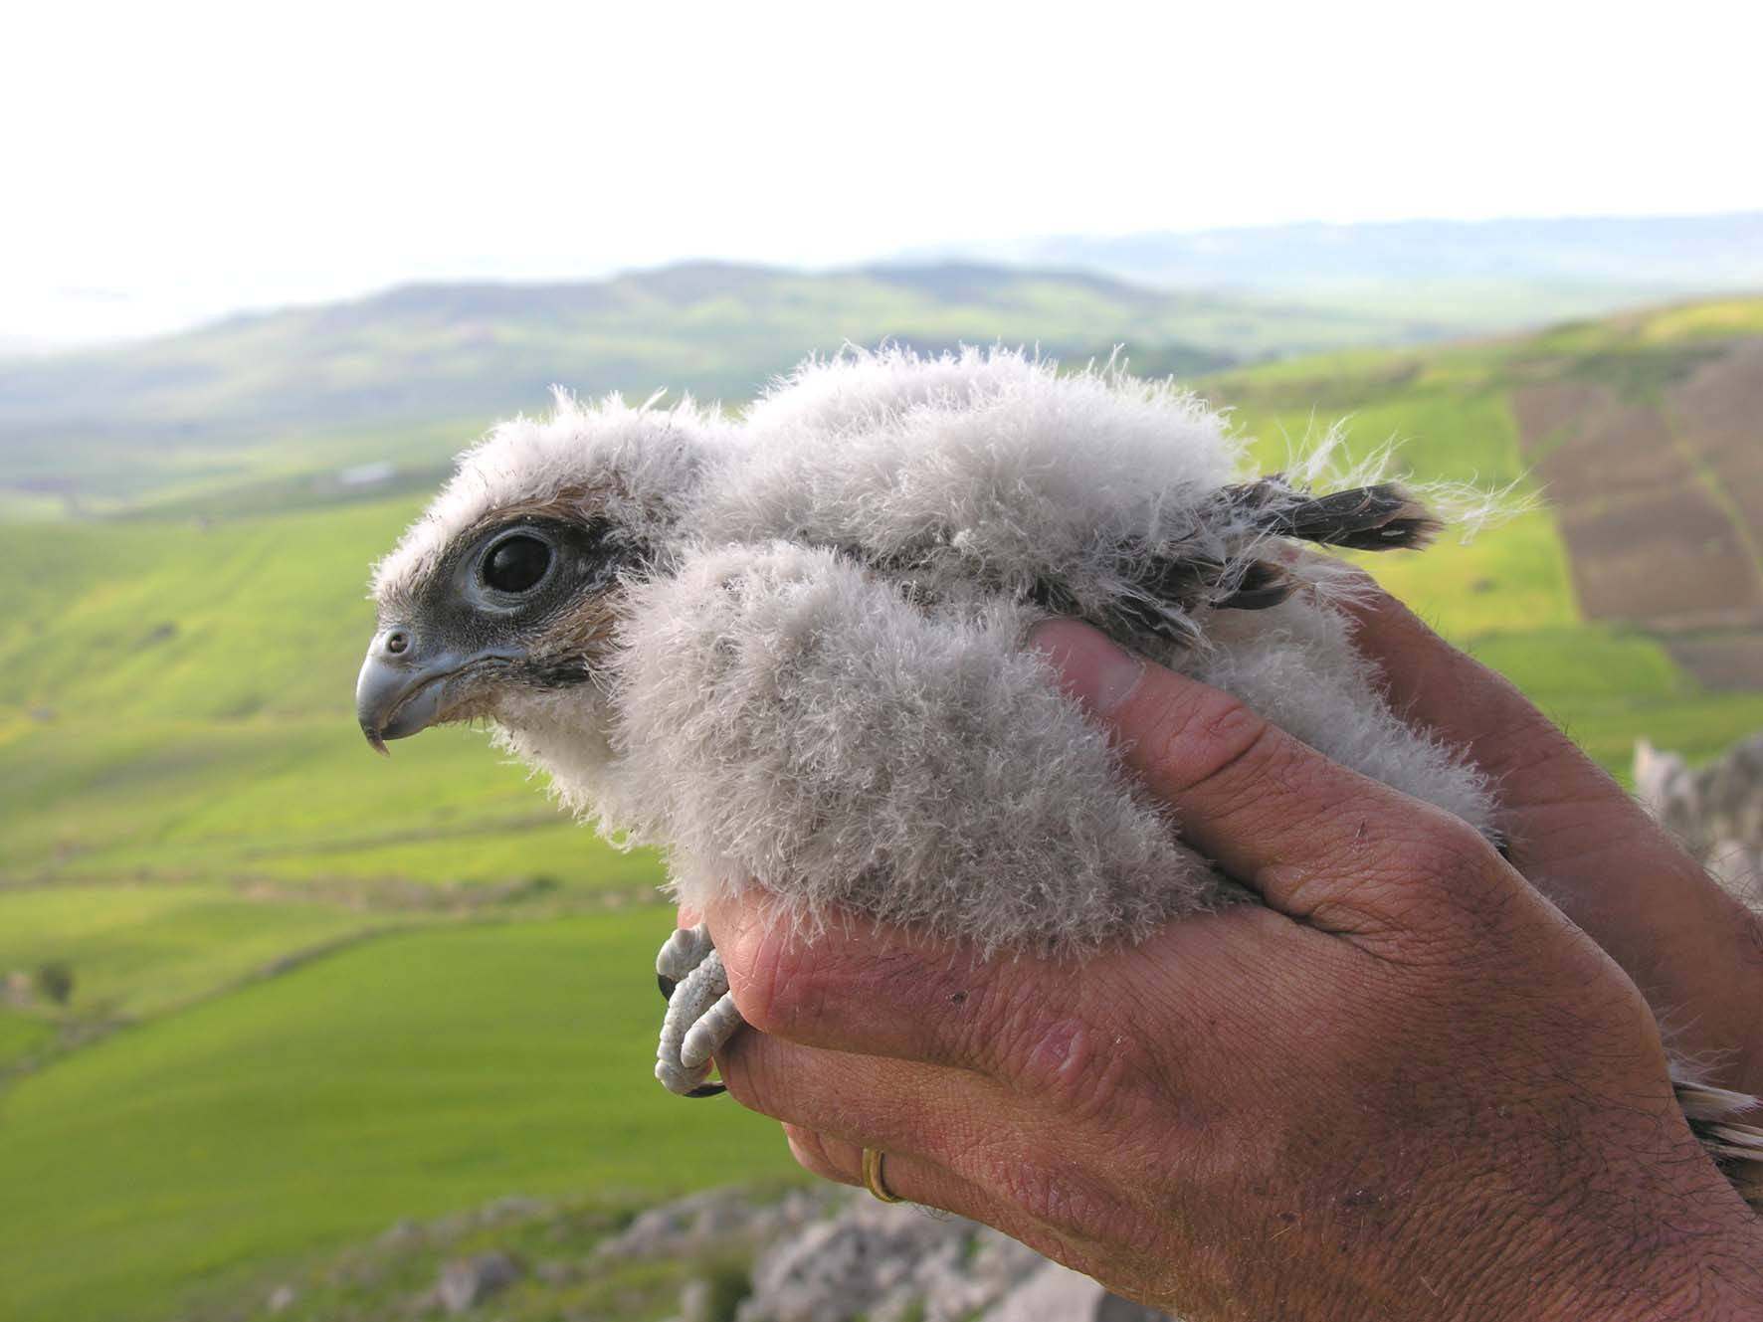
The challenge
Environmental contaminants: € multi-bn costs to human and wildlife health
EU objective (7EAP) - a non-toxic environment
EU chemicals regulations – assess risk, impose risk mitigation measures (restrict/ban)
Need biomonitoring data to:
  enhance chemical risk assessment
  enhance assessment of effectiveness of regulations
  provide early warning of emerging contaminant problems

Slide 4

Why ‘ERBFacility’
‘Facility’ (from Latin facilis – ‘easy’)
  not an infrastructure, but a ‘provision’ or ‘package’ of key elements
3 key elements:
  European Raptor Monitoring Scheme (ERBioMS)
  Distributed European Raptor Specimen Bank (ERSpeB)
  European Raptor Sampling Programme (ERSamp)

Slide 5
The goal
Underpin generation and use of raptor biomonitoring for EU regulatory applications
Use raptors as sentinel species to answer:
  What are the environmental risks of specific chemicals?
  Are chemicals regs effective in reducing environmental exposure to contaminants?
  Are there emerging contaminant problems requiring remedial action?
Thereby:
  contribute to a non-toxic environment
  Reduce contaminant toll on human and wildlife health

Slide 6
The three ’Arenas’
Field
Collections
Analysis
Analysis
  labs, ecotoxicologists
Collections
  NHMs, ESBs, other collections
Field
  field ornithologists/ecologists, raptor conservationists

Slide 7



Capacity Building Objectives
R1 Analysis Arena: assess current analytical capacities, develop framework for ERBioMS
R2 Collections Arena: assess current collection capacities, develop framework and protocols for distributed ERSpeB
R3 Field Arena: assess current field capacities, develop framework, standards and protocols for ERSamP

Slide 8
Research Coordination Objectives
C1 - Analysis arena
  Collaborative work on ERBioMS
  Piloting joint assessment and reporting
  Developing guidance on integrating reports with regulatory assessments
C2 - Collections arena
  Collaborative work on ERSpeB
  Constructing meta-database of samples/data
  Stimulating expansion of raptor collections
C3 - Field arena
  Collaborative work on ERSamP
  Stimulating/harmonising collection of raptor samples and contextual data
  Developing and field-testing sampling framework, standards and protocols

Slide 9
Management Structure

Slide 10
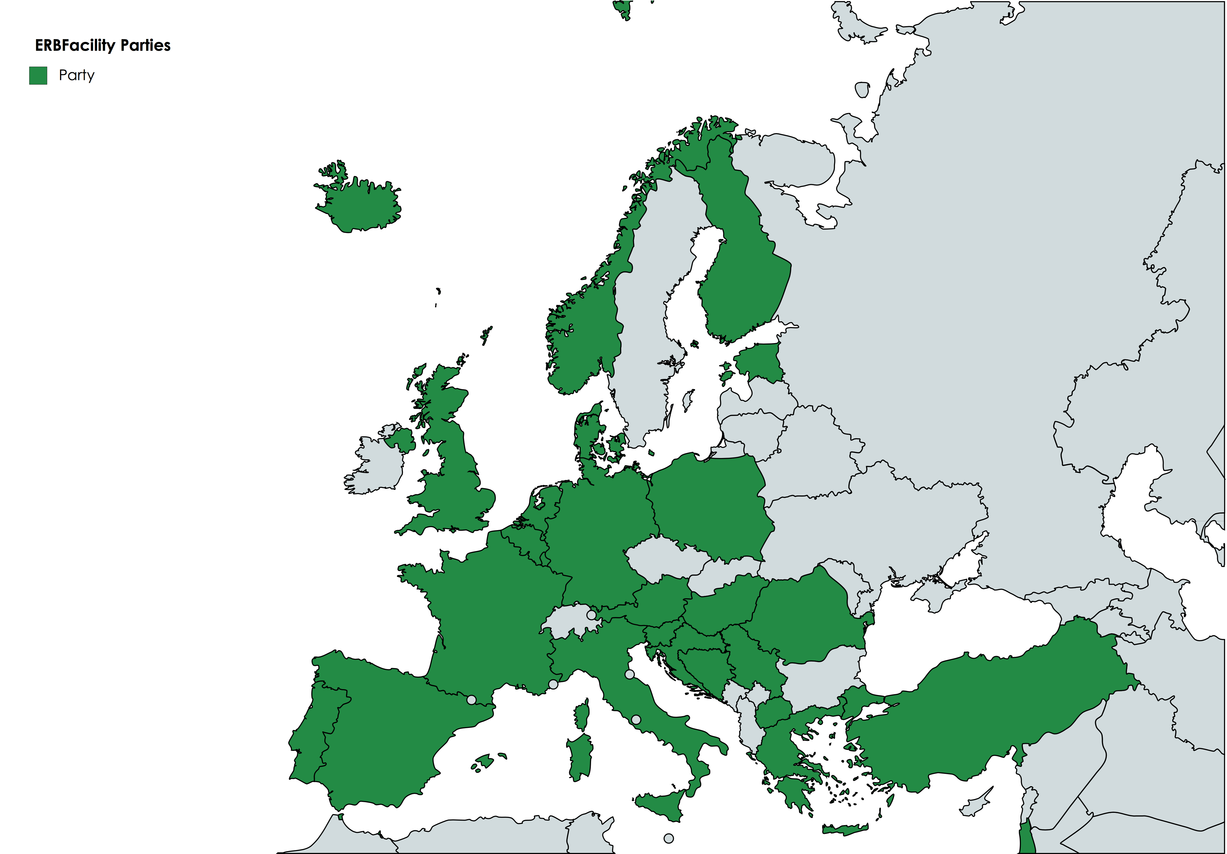

Parties to ERBFacility
26 Parties - more expected to join
45 MC Members
19 MC Substitutes

Slide 11
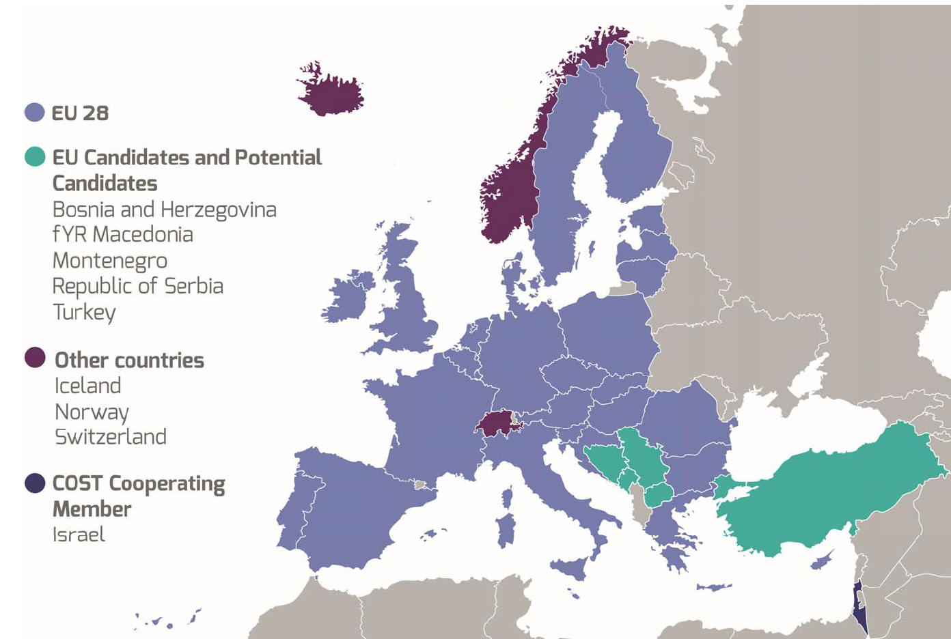



COST policies
Geographical coverage/ICT countries
  26 of 37 COST countries
  11 of 25 Parties ICT (40%)
Gender balance
  Only 12 of 44 Members female
  2 of 4 WG Leads female
Early Career Investigators
  Several ECIs on MC

Slide 12





Relations to existing efforts
EURAPMON – monitoring for and with raptors
HBM4EU – human biomonitoring
NORMAN – monitoring of emerging substances
IPCheM – European platform for chemical monitoring
GBIF – Global biodiversity information facility

Slide 13




COST Activities
Meetings
  Management Committee & Core Group
  General and WG meetings
  Dissemination meetings
Short-term scientific missions
  5-90 days
  ECI STSMs: 91-180 days
Training schools
  Joint WG 1&2
  Joint WG 3&4
Dissemination and communication activities

Slide 14
Main Deliverables
WGs 1 & 2
  ERBioMS technical specs
  Papers – lab analyses capacities, ERBioMS framework
  Pilot reports – selected substances
  Proof of concept, guidance for integration with regulatory processes
WG3
  ERSpeB technical specs
  Meta-database of samples & linked data
  Guidance – use of collections for contaminant monitoring
  Papers – collections/constraints, ERSpeB framework
WG4
  ERSamP technical specs
  Best practice guidance, protocols for sampling
  Guidance – volunteer recruitment
  Reports – proof of concept, network of collaborating organisations

Slide 15
Expected Impact
Analysis arena
  European capability for pan-European assessment of contaminant exposure
  Pan-European consensus on priority species/samples
  Clarity on integration of these assessments with regulatory processes
Collections arena
  New distributed ERSpeB
  Enhanced access to samples and related data
Field arena
  New European approach to collection of samples
  Enhanced sampling capabilities

Slide 16
Dissemination/exploitation
Dissemination and Exploitation Plan
Dissemination and communication tools:
  Website
  Social media
  Publications – frameworks, proof of concept reports, tech specs, guidance, protocols
  High impact papers
  Media articles
Exploitation opportunities

Slide 17
MILESTONES - WGs 1 & 2
(to end Grant Period 2 - 30 April 2019)
WG1
  M1.1 – WS: WG1 Workplan [m6, Apr18]
  M1.2 – STSM: ability to conduct pan-European assessment for priority contaminants (m10, Aug18)
  M1.3 – WS: developing concept for pan-European assessment of priority contaminants (m15, Jan19)
  M1.4 – STSM: developing technical specs for ERBioMS (m18, Apr19)
WG2
  M2.1 – WS: WG2 Workplan (m6, Apr18)
  M2.2 – STSM: ability to conduct pan-European assessment for PPPs, biocides & medicinal products (m10, Aug18)
  M2.3 – WS: developing concept for pan-European assessment of PPPs, biocides and medicinal products (m15, Jan19)
  M2.4 – STSM: developing technical specs for ERBioMS (m18, Apr19)

Slide 18
MILESTONES - WGs 3 & 4
(to end Grant Period 2 - 30 April 2019)
WG3
  M3.1 – WS: WG3 Workplan (m6, Apr18)
  M3.2 - STSM: consideration for development of ERSpeB framework (m9, Jul18)
  M3.3 – WS: framework for distributed ERSpeB (m18, Apr19)
WG4
  M4.1 – WS: WG4 Workplan, scoping of framework (m6, Apr18)
  M4.2 – STSM: R&D questionnaire on constraints to data gathering (m12, Oct18)
  M4.3 – WS: Development of ERSamP framework 1: pan-European review of field protocols and monitoring results for selected species (m12, Oct18)
  M4.4 – WS: Development of ERSamP framework 2: outlining the framework (m18, Apr19)

